Slide 1
CALIFORNIA HOUSING LEGISLATION, 2017 & 2018 JOHN C. TERELL, AICP , VP, POLICY & LEGISLATION barb kautz, Goldfarb & lipman llP ERIC PHILLIPS, GOLDFARB & LIPMAN llp SANDE GEORGE, STEFAN/GEORGE ASSOCIATES LAUREN DE VALENCIA, STEFAN/GEORGE ASSOCIATES
November 9, 2017

Slide 2
FAIR WARNING: 2017 IS JUST THE BEGINNING
APA California tracked 225 bills related to planning.
There were 130 bills introduced related to housing alone this year - MANY MORE BILLS ARE ALREADY BEING DRAFTED FOR 2018.
2018 is second year of two-year session so bills that didn’t pass this year can still move next year.
To see a full list of all hot bills being tracked by APA California go to: https://www.apacalifornia.org. J

Slide 3
APA CALIFORNIA Housing GUIDELINES
APA California took a general position this year that housing measures should:
Produce more housing rather than adding more analysis and paperwork.
Provide funding for affordable housing, infrastructure to support that housing, and planning.
Increase enforcement of existing housing laws in a manner that respects due process, does not target cities and counties which actively support housing, and does not add additional housing element analysis or causes for private lawsuits.
Streamline development using strategies that can be realistically met. J

Slide 4
GOVERNOR’S PROCESS FOR HOUSING PACKAGE
After substantial negotiations, APA was able to reach agreement on a number of housing measures.
But – last-minute amendments from the Governor halted those negotiations.
Governor and package authors did not entertain any new amendments before the final vote, in spite of vague language, new undefined terms, and unintended results.
Governor on September 29 signed the 15 bills in the housing package: AB 72, 73, 571, 678, 879, 1397, 1505, 1515, 1521, SB 2, 3, 35, 166, 167, 540. The ADU bills were signed later. s

Slide 5
SB 35 MAY NOT BE AS SIGNIFICANT AS OTHER HOUSING PACKAGE BILLS
The top 3 bills in the housing package that received the most attention were SB 2 and SB 3, the funding measures,
and, SB 35, allowing developers to choose ministerial review of their housing projects under certain conditions.
But, due to the many requirements that a project must meet to be eligible for SB 35’s ministerial review, it is less likely to be used than advertised.
There are however many other housing bills that, combined, will require each city and county to change the way it processes housing applications and updates housing elements - these are much more significant than SB 35. S

Slide 6
OVERVIEW: THE HOUSING PACKAGE
Changes in Processing Housing Applications Effective 1- 1 - 2018
Housing Accountability Act, SB 35, and ‘No Net Loss’
New Annual Report Requirements
Return of Rental Inclusionary Requirements
ADUs
Housing Elements
New Housing Funding Sources
MUCH MUCH More in 2018
Joining the APA Legislative Review Team
Questions J

Slide 7
PROCESSING HOUSING APPLICATIONS
AB 678/SB 167; AB 1515: Housing Accountability Act Bills Affecting All Projects
SB 35: ‘Streamlining’ for Some Projects
SB 166: ‘No Net Loss’ by Income Level

Slide 8
HOUSING ACCOUNTABILITY ACT

Slide 9
PROCESSING HOUSING APPLICATIONS: HOUSING ACCOUNTABILITY ACT (65589.5)
Applies to ALL “housing development projects” and emergency shelters:
Residences only;
Transitional & supportive housing;
Mixed use projects with at least 2/3 the square footage designated for residential use.
Affordable AND market-rate

Slide 10
PROCESSING HOUSING APPLICATIONS: HOUSING ACCOUNTABILITY ACT (65589.5(j)
If complies with “objective” general plan, zoning, and subdivision standards, can only reduce density or deny if “specific adverse impact” to public health & safety that can’t be mitigated in any other way.”
“Lower density” includes conditions “that have the same effect or impact on the ability of the project to provide housing”
Honchariw v. County of Stanislaus (2011) B

Slide 11
PROCESSING HOUSING APPLICATIONS: HOUSING ACCOUNTABILITY ACT (65589.5(j)
If desire to deny or reduce density:
Identify objective standards project does not comply with.
If project complies with all, must make public health & safety finding.
Not objective: “suitability”

Slide 12
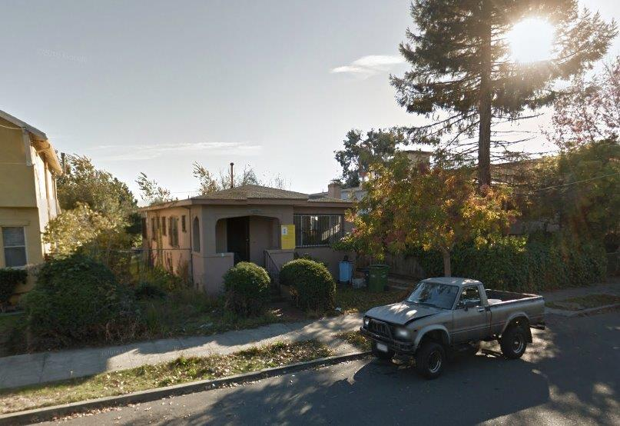
PROCESSING HOUSING APPLICATIONS: Market Rate Projects (65589.5)

Slide 13
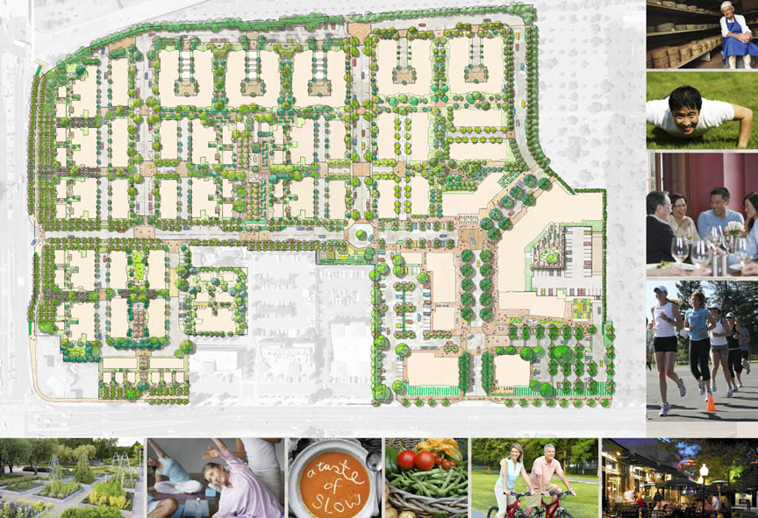
PROCESSING HOUSING APPLICATIONS: Market Rate Projects (65589.5)

Slide 14
PROCESSING HOUSING APPLICATIONS: AFFORDABLE HOUSING (65589.5(d))
Additional protections for projects:
Emergency shelters;
20% low income; or
100% moderate (120% of median) or middle income (150% of median).
Must make specific findings to deny, reduce density, or add condition making project infeasible

Slide 15
PROCESSING HOUSING APPLICATIONS: SB167/AB678; AB 1515
Must provide list of any inconsistencies with:
“Plan, program, policy, ordinance, standard, requirement or similar provision”;
Within 30-60 days of completeness;
Explaining why inconsistent; or
“Deemed consistent.”
How to treat pipeline projects complete before January 1, 2018??
B

Slide 16
PROCESSING HOUSING APPLICATIONS: SB167/AB678; AB 1515
City findings must be based on ‘preponderance of the evidence,’ not merely ‘substantial evidence’
Also “deemed consistent” if: “substantial evidence that would allow a reasonable person to conclude” is consistent
Attorneys’ fees to both market-rate & affordable
$10K/unit fine if ignore court

Slide 17
PROCESSING HOUSING APPLICATIONS: COASTAL ACT
Kalnel Gardens LLC v. City of LA (2016): in dicta Court said Coastal Act trumps HAA (see Section 65589.5(e))
Coastal Act contains subjective criteria that must be met
?? Does change in standard of review specified in the HAA apply to Coastal Act decisions??

Slide 18
PROCESSING HOUSING APPLICATIONS: CEQA
“The California Environmental Quality Act is the state’s premier environmental law.”
Schellinger Bros. v. City of Sebastopol (2009): must complete CEQA before can invoke HAA.
Sequoyah Hills HO Ass’n v. City of Oakland (1993): upheld finding that legally infeasible to reduce density due to HAA.

Slide 19
PROCESSING HOUSING APPLICATIONS: SB 35 STREAMLINING

Slide 20
PROCESSING HOUSING APPLICATIONS: SB 35 STREAMLINING
Determine if Jurisdiction is Subject to SB 35
Not enough building permits to satisfy RHNA
No Annual Report for 2 Years
Determine if Project is Eligible for Streamlining
2 or more units in urbanized area zoned or planned for residential
Meets all objective standards
Meets affordable housing and labor requirements
Determine if Exclusion Applies
Project site may not be on list of exclusions
Project must not require subdivision unless LIHTC-funded and/or meets labor requirements
Notes:
.SB 35 seeks to ‘streamline’ the approval process for some housing developments. A housing project proposed in a city or county that has not issued enough building permits to satisfy its regional housing allocation by income category would be eligible for ministerial approval provided that it complies with ‘objective’ planning standards.
This bill has received by far the most publicity of any of the land use-related housing bills and will probably have the least impact. You will see, as we go through the requirements, that very few projects will be eligible; or where it will be feasible for developers to use SB 35.

Slide 21
PROCESSING HOUSING APPLICATIONS: SB 35 STREAMLINING
Regional Housing Need Allocation (RHNA)
Typically: 40% low and very low; 20% moderate; 40% above moderate
Model City
Lower Income (Very Low and Low) | Moderate Income | Above Moderate Income | TOTAL RHNA
400 units | 200 units | 400 units | 1,000 units
Notes:
Although we think that most of you know about housing elements, we wanted to review just a few key concepts so some of these bills will make more sense.
The key requirement for housing elements is to show that the city has enough land zoned for housing at appropriate densities to accommodate its Regional Housing Need Allocation, fondly called the RHNA. The expected need for housing over the next 8 years is calculated for each region in the state by income category, and each city is given its share of the of the need. Typically 40% low and very low (incomes less than 80% of median), 20% moderate (between 80% and 120% of median income), 40% above moderate. So here is a typical distribution in our model city.

Slide 22
PROCESSING HOUSING APPLICATIONS: SB 35 STREAMLINING
Requires ministerial approval of housing if HCD determines city has not issued enough building permits to satisfy its RHNA by income category or no annual report for 2 years (“highest priority” for HCD)
Eligible Projects:
Two or more units proposed
In urban area with 75% of perimeter developed
Site zoned or planned for residential use
Consistent with ‘objective’ planning standards

Slide 23
PROCESSING HOUSING APPLICATIONS: SB 35 STREAMLINING
Eligible Projects (cont.):
Must meet affordable housing requirements
Projects with 10 or more units must pay prevailing wages
Must use “skilled and trained workforce” if 75 units or more in coastal or bay counties over 225,000 population and other counties over 550,000 population

Slide 24
PROCESSING HOUSING APPLICATIONS: SB 35 STREAMLINING
Exclusions:
Site must not have contained housing occupied by tenants within last 10 years
Site must not be in the coastal zone, agricultural land, wetlands, fire hazard areas, hazardous waste sites, former mobilehome park, floodplain, floodway, fault zone, or other specified areas
Project may not involve a subdivision unless financed with low income housing tax credits and pays prevailing wage or satisfies all labor requirements

Slide 25
PROCESSING HOUSING APPLICATIONS: SB 35 STREAMLINING
No parking standards may be imposed if the project is:
Located within one-half mile of public transit
Located within an architecturally and historically significant historic district
In an area where on-street parking permits are required but not offered to the occupants of the development
Within one block of a car share vehicle
No more than 1 space/unit for all other projects

Slide 26
PROCESSING HOUSING APPLICATIONS: SB 35 STREAMLINING
Within 60 to 90 days of submittal:
Provide list of all inconsistencies with ‘objective’ zoning and design review standards in effect at submittal or project “deemed consistent”
‘Objective’ means “no personal or subjective judgment by a public official and uniformly verifiable by reference to an external and uniform benchmark.”
Development is consistent with density requirements if it is within the maximum density permitted by general plan or zoning

Slide 27
PROCESSING HOUSING APPLICATIONS: SB 35 STREAMLINING
Within 90 to 180 days of submittal:
Complete any design review or “public oversight” of a housing development
Prohibited from in any way “inhibiting, chilling or precluding” the ministerial approval of a project
Review must be “objective and be strictly focused on assessing compliance with criteria required for streamlined projects”

Slide 28
PROCESSING HOUSING APPLICATIONS: HAA AND SB 35 STRATEGIES
Critical to assemble complete packet of “plans, programs, policies, ordinances, standards, requirements”
Detailed list of eligibility requirements for SB 35
Require applicant to evaluate “consistency” as part of complete application (doesn’t work for SB 35)
Use planning funds to create ‘objective’ guidelines (but are coastal zone policies excluded?)
Can conditions of approval be incorporated?
How will CEQA be integrated?

Slide 29
HCD: SB 35 ELIGIBLE CITIES
HCD intends to designate the eligible cities shortly after Jan 1.
A preview of the Housing Element Open Data Project has been sent to local governments; made up of two housing element data resources:
1. The Housing Element Implementation spreadsheet
2. Annual Progress Report Permit Summary
Jurisdictions will have a three-week review period to provide additional information or corrections to the data before this information is available publically on HCD’s website.

Slide 30
HCD: SB 35 ELIGIBLE CITIES
The review period will not be the only opportunity to provide new data or corrections - after the initial review period, corrections and additional data will continue to be accepted and the data will be updated periodically.
HCD is available to answer questions or provide technical assistance through their APR Technical Assistance Team: APR@HCD.CA.GOV

Slide 31
PROCESSING HOUSING APPLICATIONS: ‘NO NET LOSS’

Slide 32
PROCESSING HOUSING APPLICATIONS ADEQUATE RHNA SITES
Must designate specific sites that can “accommodate” the RHNA at each income level during the planning period (65583.2).
Sites “accommodating” lower income housing must be at “default densities” of 10 – 30 du/A.
APN | Zone | DU/A | Acres | Units | Use | Income Category
041-0042-002 | R-3 | 20-30 du/ac | 2.0 | 40 | Vacant | Lower
037-0400-027 | R-2 | 10-20 du/ac | 0.75 | 7 | Duplex | Moderate
038-0100-040 | R-1 | 5-10 du/ac | 4.5 | 22 | Vacant | Above Moderate
039-1100-039 | CMU | 20 du/ac | 1.5 | 25 | Parking | Moderate
Notes:
To show there is enough land zoned for housing to “accommodate” the RHNA, a city must do an inventory of land zoned for housing that identifies specific sites, describes the density permitted, and states specifically how many units can be accommodated. Every housing element contains a table something like this one.
Additionally, the city must identify whether the site is suitable for lower, moderate, or above moderate income housing. Certain densities are ‘deemed appropriate’ for lower income housing. For this city, densities need to be at least 30 units per acre (describe chart).
The two things to remember from this chart, which come into play later, are:
How many units are shown on the site?
What income category is the site intended to meet?

Slide 33
PROCESSING HOUSING APPLICATIONS NO NET LOSS OF INVENTORY SITES (65863)
Applies when:
Any site in inventory either downzoned to reduce density; or approved at lower density than shown; OR
Site approved with fewer units at the income level shown in the inventory.
Only applicable to counties and general law cities.

Slide 34
PROCESSING HOUSING APPLICATIONS: ‘NO NET LOSS’ REQUIRED FINDINGS
OK if:
Reduction consistent with GP and Housing Element; and
Remaining sites in Element are adequate at all income levels. Must quantify unmet need and remaining capacity by income level.
If remaining sites are not adequate, can ID “additional, adequate, and available sites” so ‘no net loss.’
Solely city’s responsibility unless developer’s application had lower density; developer has no responsibility for income level. City cannot deny because developer’s project results in need for additional sites.

Slide 35
PROCESSING HOUSING APPLICATIONS ‘NO NET LOSS’ OPTIONS
Remaining sites in Element adequate to meet the RHNA at all income levels; or
Ways to “identify and make available”:
City approved more units on some site than shown in inventory or has other units at that income category; or
Other sites NOT in Element can make up difference; or
Another site “identified and made available.” (Rezoning) Time limit of 180 days for income category only.

Slide 36
PROCESSING HOUSING APPLICATIONS ‘NO NET LOSS’ ISSUES
Does not require that Housing Element be amended when additional sites are identified; but must be reported in annual report
How should CEQA review of any necessary rezoning be accomplished?
Impetus to require on-site inclusionary housing. Can projects be required to meet housing element income categories?

Slide 37
PROCESSING HOUSING APPLICATIONS ‘NO NET LOSS’ PRACTICE TIPS
Maximize inclusionary percentages; consider ALWAYS requiring actual production of units
Can ADUs be required to be affordable with Palmer fix?
Keep a log of:
All housing element sites;
All approved housing by income category on other sites;
All sites not in housing element identified as ‘available.’

Slide 38
PROCESSING HOUSING APPLICATIONS: PUTTING IT ALL TOGETHER
No Net Loss
Is the project on a Housing Element site in a county or general law city?
Must provide at least the number of units listed in the Housing Element at the income level shown in the Housing Element or comply with ‘no net loss’ (Section 65863)
Also applies to non-residential approvals on housing element sites
HAA
Is the project a “housing development project”?
Must advise on consistency within 30 – 60 days of completeness
Specific findings required to deny or reduce density
Additional findings required to deny or reduce density if project is affordable or an emergency shelter
SB 35
Does the project qualify for streamlining?
Must advise on consistency within 60 – 90 days of submittal
Must complete “public oversight” within 90 – 180 days
Notes:
Is the project on a Housing Element site? If so:
Does it have at least the number of units listed in the Housing Element at the income level shown in the Housing Element? If not, comply with ‘no net loss’ (Section 65863)
Note this applies also to non-residential approvals on housing element sites
Is it a ‘housing development project’ under the HAA? If so:
Must advise on consistency within 30 – 60 days of completeness
Does City plan to reduce density or deny? Must either find non-compliance with objective City standards or make “specific adverse impact” finding. (Section 65589.5(j).) May be able to find non-compliance with Coastal Act on non-objective basis.
Is it also an affordable project or emergency shelter under the HAA? If so:
Does City plan to deny or reduce density or adopt condition making project infeasible? If so: must make one of 5 findings under Section 65589.5(d).
Does it qualify for SB 35 approval? If so:
Must advise on consistency within 60 – 90 days of submittal
Must complete “public oversight” within 90 – 180 days

Slide 39
ANNUAL REPORT CHANGES

Slide 40
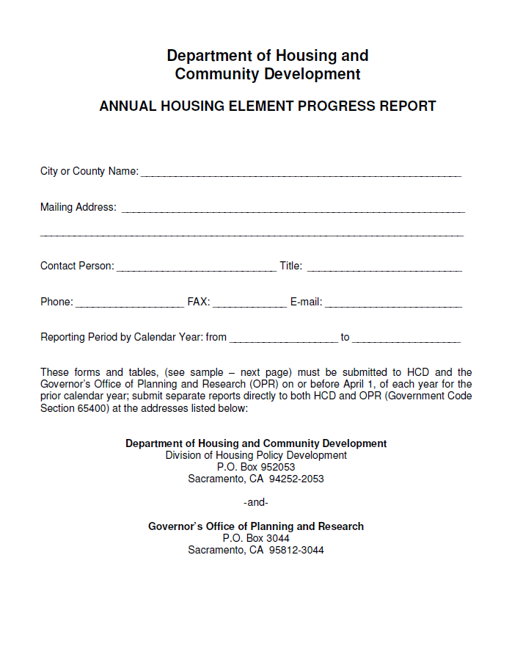
ANNUAL REPORT CHANGES
SB 35 & AB 879
Housing Element annual reports required from all jurisdictions
New requirements regarding report contents
AB 879 directs HCD to evaluate “reasonableness” of local development fees under the Mitigation Fee Act

Slide 41
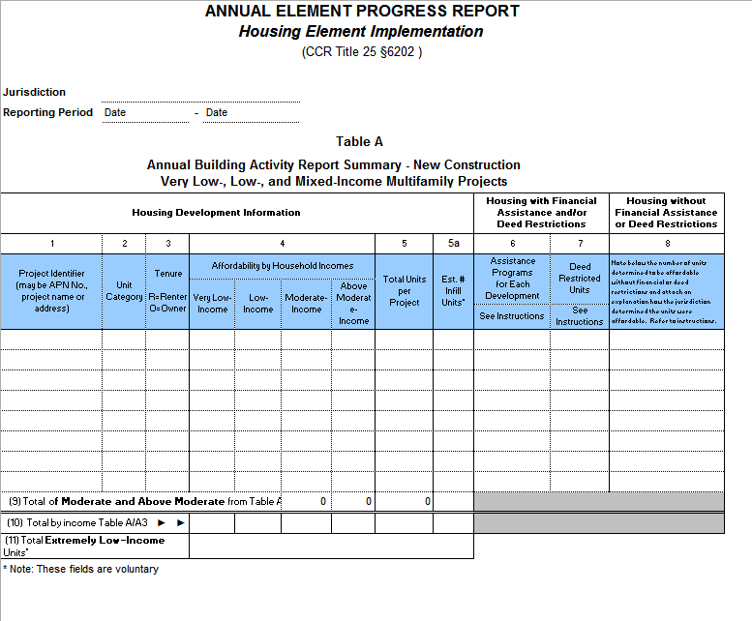
HOUSING ELEMENTS & ANNUAL REPORTS: CURRENT ANNUAL REPORTS
Notes:
Current Form available at http://www.hcd.ca.gov/community-development/housing-element/index.shtml
Approved via Cal administrative procedure act, e.g. notice and comment rulemaking. New forms and guidelines are not subject to the Cal APA.

Slide 42
ANNUAL REPORTS: NEW REQUIREMENTS
Prior year Applications
Housing development applications received.
Units in all applications: approved & disapproved.
Sites rezoned to accommodate RHNA.
Sites identified or rezoned for No Net Loss.
Production Report Net new units entitled, permitted, or occupied.
For sale or rental.
RHNA income category.
Assessor Parcel Number.
SB 35 Report
Applications & sites.
Units by type & RHNA .
Notes:
A production report that identifies: BETSY
- The number of net new units of housing (both rental and for-sale) that have been issued a "completed entitlement," a building permit, or a certificate of occupancy, thus far in the housing element cycle. The term "completed entitlement" is defined in the streamlining provisions of SB 35 as "all required land use approvals or entitlements necessary for issuance of [a] building permit" (Gov. Code 65913.4). It appears likely this definition will be used for the annual reports; and
- The income category that each new housing unit satisfies, based on the anticipated area median income of the future occupants, presumably in accordance with the RHNA categories (e.g. very-low, lower, moderate, and above-moderate income categories); and
- A unique site identifier for each entitlement, building permit, or certificate of occupancy, including the assessor parcel number.
A report on the impact of SB 35's streamlining provisions (Government Code 65913.4), including the number of applications for streamlining, the location and number of each development approved and building permit issued via SB 35 streamlining, and the total number of units constructed via streamlining by income category and noting whether the unit is for rent or sale.

Slide 43
ANNUAL REPORTS WHEN ARE THEY DUE?
Now applicable to charter cities.
HCD to publish new reporting forms.
HCD will publish each report online.
Annual Reports due by April 1 each year.
HCD states new info not required until April 2019 report.
Failure to submit two or more consecutive Annual Reports triggers SB 35 streamlining.

Slide 44
RETURN OF RENTAL INCLUSIONARY ZONING

Slide 45
RETURN OF RENTAL INCLUSIONARY ZONING
AB 1505 restores the ability of cities and counties to adopt inclusionary housing policies for rental projects
The Bill explicitly supersedes the California Court of Appeal’s 2009 decision in Palmer/Sixth Street Properties LP v. City of Los Angeles (Palmer)
The policies must meet certain standards and the Department of Housing and Community Development (HCD) may review the policies in certain circumstances

Slide 46
RETURN OF RENTAL INCLUSIONARY ZONING: ORDINANCE REQUIREMENTS
Local governments may require new rental housing include percentage of affordable units
Ordinances must provide “alternative means of compliance” with inclusionary requirements
Alternatives may include, but are not limited to:
In lieu fees
Land dedication
Off-site development of units
Acquisition and rehabilitation of existing units

Slide 47
RETURN OF RENTAL INCLUSIONARY ZONING: ECONOMIC FEASIBILITY
HCD may require that a city or county submit an economic feasibility study to support certain inclusionary ordinances.
If the economic feasibility study does not meet HCD standards, the city or county may not impose an ordinance requiring higher than a 15 percent rental inclusionary requirement.

Slide 48
RETURN OF RENTAL INCLUSIONARY ZONING: IMPLEMENTATION OPTIONS
Existing Inclusionary Ordinances:
May be implemented after January 1, 2018.
If the ordinance was adopted before September 15, 2017, no HCD review or economic feasibility study required
New Inclusionary Ordinances:
May be subject to an HCD request for an economic feasibility study if:
it requires more than 15 percent of rental units be affordable to low-income households

Slide 49
RETURN OF RENTAL INCLUSIONARY ZONING: IMPLICATIONS
Need for ordinance: AB 1505 authorizes local communities to adopt rental inclusionary requirements by ordinance. An ordinance should be adopted to implement inclusionary requirements contained in general plans, housing elements, or other policy documents.
No nexus study needed: No nexus study is required to justify a rental inclusionary requirement.

Slide 50
ADU & EFFICIENCY UNIT CLEANUP BILLS

Slide 51
ADU & EFFICIENCY UNIT CLEANUP BILLS
AB 494/SB 229 continue to ease ADU restrictions
Local ordinances are void unless they comply with Government Code Sec. 65852.2
HCD expressly authorized to review ordinance

Slide 52
ADU & EFFICIENCY UNIT CLEANUP BILLS
Exterior ADUs
Interior ADUs
Local governments may designate areas where ADUs are permitted
Areas can include anywhere existing or proposed single-family home is permitted
Local government must approve in any district where single family homes are permitted

Slide 53
ADU & EFFICIENCY UNIT CLEANUP BILLS
Parking
For exterior ADUs, limited to 1 space per unit or bedroom, “whichever is less”
Reduced ability to limit tandem parking or parking in setbacks
Utility Fees
Restrictions on charges extended to special districts and water corporations, along with other defined local agencies

Slide 54
AB 352 (Santiago) efficiency units Restrictions
This bill prohibits a city or county from doing the following:
Limiting the number of efficiency units in an area located within one-half mile of public transit or where a car share vehicle is located within one block of the efficiency units.
Limiting the number of efficiency units in an area located within one mile of a University of California or California State University campus. L

Slide 55
HOUSING ELEMENT BILLS

Slide 56
HOUSING ELEMENT BILLS ENFORCEMENT OF HOUSING LAWS
HCD may revoke housing element compliance
May review actions or “failure to act” that is inconsistent with an adopted housing element or state housing element law, including failure to implement housing element program
City or county has maximum of 30 days to respond
May refer violations to Attorney General
May also notify AG that city is in violation of HAA, no net loss, density bonus law, or anti-discrimination provisions.
No $$ for AG to prosecute

Slide 57
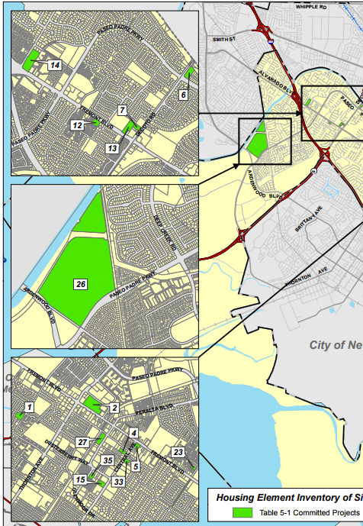
HOUSING ELEMENT REQUIREMENTS
Site Inventory “realistic & demonstrated potential”
Access to water, sewer, & dry utilities
Units per Site (Site Capacity) “realistically accommodated”
Density of similar projects with similar affordability on similar sites
Notes:
NOT DUE FOR 6 YEARS
-"realistic and demonstrated potential" for identified sites to accommodate housing development. While the realistic and demonstrated potential is not clearly defined, new requirements for the site inventory may shed light. The site inventory must now identify each property by its assessor parcel number (rather than allowing other identifiers) and then describe whether the property either currently has access to sufficient water, sewer, and dry utilities, or is scheduled to have such access according to an adopted plan.
number of units that can "realistically be accommodated" on site, but AB 1397 requires more justification of the number of units identified for each site, including a review of the density of projects on similar sites in the jurisdiction and at similar affordability levels.
Images: Fremont Housing Element 2015, Table 5-1

Slide 58
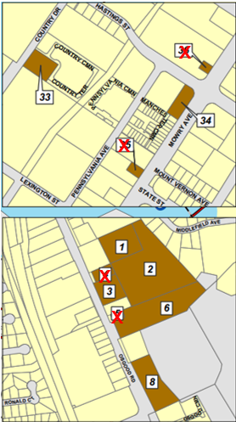
HOUSING ELEMENT REQUIREMENTS
Site Size Presumed inappropriate for housing affordable to lower income households
Less than ½ Acre
Greater than 10 Acres
Evidence to rebut presumption
Project proposed
Project approved
On site of this size
Notes:
size and current use of the site. Sites smaller than one-half acre and those larger than ten acres are presumed to be inappropriate for development of housing affordable to lower income households, unless the jurisdiction can provide evidence why the site would be appropriate. Acceptable evidence includes either a proposal for or an approved development project affordable to lower income households for the site.
Images: Fremont Housing Element 2015, Table 5-2

Slide 59
HOUSING ELEMENT REQUIREMENTS
Previously Identified Sites
Presumed inappropriate for housing affordable to lower income households:
Vacant sites listed in two or more housing elements
Non-vacant sites listed in one housing element
Evidence to rebut presumption:
Zoning for minimum lower-income density; and
Zoning allows development by-right if 20% of units are affordable

Slide 60
HOUSING ELEMENT REQUIREMENTS
Non-vacant Sites
Development potential requires analysis of both:
Prior experience converting to higher density residential
Market demand and existing contracts for current use
Substantial evidence required if more than 50% of lower income housing need fulfilled by non-vacant sites
One-For-One Replacement Obligation
Units occupied by lower income households (within 5 years), restricted units, & units subject to local rent control

Slide 61
HOUSING ELEMENT REQUIREMENTS
Governmental Constraints | Nongovernmental Constraints
“any locally adopted ordinances that directly impact the cost and supply of residential development” | “requests to develop housing at densities below those anticipated” “the length of time between receiving approval for a housing development and submittal of an application for building permits”
Mitigation Fees Zoning Constraints
Notes:
The analysis of governmental constraints on the production of housing must specifically address "any locally adopted ordinances that directly impact the cost and supply of residential development." Such ordinances likely include mitigation fees related to traffic, parks, and utilities, but could potentially be interpreted to include typical zoning constraints like height limits or mandatory setbacks from streets and lot lines.
Finally, the housing element must expand the analysis of nongovernmental constraints on the production of housing. AB 1397 requires that this analysis discuss any requests to develop housing at densities below the density identified for the site in the land inventory, describe the length of time between project approval and a request for building permits, and identify local efforts to address nongovernmental constraints.

Slide 62
MAJOR HOUSING FUNDING BILLS

Slide 63
SB 2: PERMANENT SOURCE
SB 2: Permanent Source for Housing— $75 Recording Fee
Estimated $200- $300 million/year for local governments and HCD to fund affordable housing development

Slide 64
SB 2: PERMANENT SOURCE
Year 1
Year 2 and Beyond . . .
Notes:
General overview of how funds will be allocated, will go into specifics in next slides
Legislation provides for 2 phases of the funding

Slide 65
SB 2: PERMANENT SOURCE
Year 1 (Jan 2018- Dec 2018):
50% to local governments to streamline housing production
Update planning documents and zoning ordinances
Must submit requests to HCD
50% to HCD to combat homelessness
Funds Mostly Available in 2019

Slide 66
SB 2: PERMANENT SOURCE
Year 2 and Beyond (Jan 2019 – beyond):
70% to local governments to support affordable housing, homeownership opportunities, and other housing-related programs
30% to HCD for specified purposes
“Workforce housing”: 20% of ALL funds for affordable owner-occupied “workforce housing”

Slide 67
SB 2: PERMANENT SOURCE
70% of funds to local governments:
90% allocated based on CDBG formula
Exception: funds allocated to nonentitlement areas distributed by HCD through competitive grant programs
10% allocated equitably among nonentitlement areas using CDBG formula

Slide 68
SB 2: PERMANENT SOURCE
Minimum Requirements for Local Governments:
Submit plan to HCD showing how will meet RHNA and how funds will be used for eligible purposes
“Compliant” housing element
Annual report to HCD
Use for eligible purposes (broad definition)
Prioritize increasing housing supply to households at or below 60% AMI

Slide 69
SB 2: PERMANENT SOURCE
Two or more cities may spend allocation on a joint project
HCD is authorized to adopt guidelines in consultation with "stakeholders" to implement and determine allocation methodologies without need to issue regulations under the Administrative Procedures Act.

Slide 70
SB 2: PERMANENT SOURCE
Remaining 30% of funds to HCD:
5% for state incentive programs
10% for affordable homeownership and rental housing opportunities for agricultural workers
15% to CalHFA to create mixed income multifamily residential housing for lower or moderate income households.

Slide 71
SB 2: PUTTING IT ALL TOGETHER
Year 1
Year 2 and beyond
Opportunity for public agencies to create planning documents to streamline housing applications
Minimal standards in legislation
HCD guidelines will be critical to determine how funds are used
Notes:
Year 1: package planning documents to streamline housing applications
PUBLIC AGENCIES:
Specific plans
General plans
Design guidelines
Review planning documents –how to convert into “objective standards”
Needs to look like streamlining
$ will be available after 1st quarter in March
DEVELOPERS
Can try to influence streamlining
Might be better look to 50% at HCD homelessness
Year 2: HCD guidelines will be critical
Stakeholder meetings

Slide 72
SB 3: VETS AND AFFORDABLE HOUSING BONDS
Bond measure on Nov 6, 2018 ballot to raise:
$3 billion for existing state affordable housing programs
$1 billion for veterans’ home purchase program
Notes:
Year 1: package planning documents to streamline housing applications
PUBLIC AGENCIES:
Specific plans
General plans
Design guidelines
Review planning documents –how to convert into “objective standards”
Needs to look like streamlining
$ will be available after 1st quarter in March
DEVELOPERS
Can try to influence streamlining
Might be better look to 50% at HCD homelessness
Year 2: HCD guidelines will be critical
Stakeholder meetings

Slide 73
HCD HOUSING LEGISLATION IMPLEMENTATION GUIDANCE
If you have questions about implementation, email them to HCD.
HCD intends to put out FAQs and it helps HCD to know what the issues are.
Send an email to HCD’s Housing Package email which is LHP@hcd.ca.gov.
HCD now also has a new website up for just this purpose.
http://www.hcd.ca.gov/policy-research/lhp.shtml
Please also copy Sande George on any questions sent to HCD: sgeorge@stefangeorge.com

Slide 74
2018
2017 WAS ONLY THE BEGINNING OF HOUSING LEGISLATION

Slide 75
FIXING THE HOUSING CRISIS – ROUND 2
CLEANUP LAST-MINUTE CHANGES IN HOUSING PACKAGE MEASURES
REDUCE MITIGATION FEES/SCALE TO SIZE OF UNIT
INCREASE RHNA NUMBERS - MAKE RHNA ALLOCATION MORE BALANCED AMONG JURISDICTIONS
REDUCE TIMELINES IN PERMIT STREAMLINING ACT

Slide 76
FIXING THE HOUSING CRISIS – ROUND 2
EXEMPT HOUSING PROJECTS NOT YET ENTITLED FROM NON-SAFETY RELATED NEW BUILDING CODES
ANOTHER MAJOR ADU MEASURE
STREAMLINE SB 375 CEQA EXEMPTION FOR INFILL
AB 686: ADD FEDERAL AFFIRMATIVELY FURTHER FAIR HOUSING REGULATION TO CA LAW – PLUS?

Slide 77
FIXING THE HOUSING CRISIS – ROUND 2
ADD INCENTIVES/STREAMLINING FOR WORKFORCE HOUSING & FIRST TIME HOMEOWNERS: FEDERAL HOUSING ADMIN PROGRAM TO ALLOW NO DOWN PAYMENT FOR HOME LOANS OF $424,100 OR LESS
MAKE MINISTERIAL DESIGN REVIEW MANDATORY FOR SPECIFIC PROJECTS – DEFINE OBJECTIVE DESIGN STANDARDS
REDUCE AIRBNB IN TIGHT RENTAL MARKETS

Slide 78
RENT CONTROL BALLOT MEASURE
PROPOSED BALLOT MEASURE:
THE AFFORDABLE HOUSING ACT
REPEALS COSTA-HAWKINS ACT WHICH BANS RENT CONTROL ON HOMES AND APARTMENTS BUILT AFTER 1995
ALLOWS CITIES AND COUNTIES TO DETERMINE THEIR OWN RENT CONTROL RESTRICTIONS ON NEWER UNITS
AND ESTABLISH VACANCY CONTROL

Slide 79
GAVIN NEWSOM’S PROPOSAL TO QUADRUPLE ANNUAL HOUSING PRODUCTION
BASED ON MCKINSEY STUDY
INCREASE ANNUAL HOUSING PRODUCTION FROM 100,000 NEW HOMES TO 378,000
THAT AMOUNT HASN’T BEEN BUILT SINCE 1954
POLICY CHANGES TO GET THERE:
EXPAND BY $500 MILLION THE LOW-INCOME HOUSING INCOME TAX CREDIT PROGRAM TO BUILD MORE AFFORDABLE HOMES

Slide 80
GAVIN NEWSOM’S PROPOSAL TO QUADRUPLE ANNUAL HOUSING PRODUCTION
ALLOW CITIES TO SEQUESTER LOCAL TAX DOLLARS TO HELP FINANCE NEW DEVELOPMENT IN CERTAIN NEIGHBORHOODS
LINK STATE TRANSPORTATION FUNDING TO LOCAL GOVERNMENTS’ HOUSING GROWTH TARGETS, “WHICH CITIES AND COUNTIES CURRENTLY HAVE LITTLE INCENTIVE TO MEET”
APPOINT A HOMELESSNESS CZAR

Slide 81
GAVIN NEWSOM’S PROPOSAL TO QUADRUPLE ANNUAL HOUSING PRODUCTION
REVAMP LOCAL TAX INCENTIVES SO IT MAKES MORE FINANCIAL SENSE FOR CITIES TO APPROVE NEW HOMES:
PROVIDE MORE STATE SUBVENTIONS ON A PER CAPITA BASIS
DISTRIBUTE INTERNET SALES TAX ON A PER CAPITA BASIS RATHER THAN SITE-BASED SALES

Slide 82
MISSING KEY HOUSING CRISIS FACTORS
NEW REQUIREMENTS STILL ASSUME THAT LOCAL GOVERNMENT IS THE WHOLE PROBLEM
LIMITED FINANCIAL ASSISTANCE
IGNORES LIMITED LABOR SUPPLY, MATERIAL COSTS, PRICE OF LAND, SALES AND RENTAL PRICES

Slide 83
REBUILDING AFTER THE FIRES
ALLOW CEQA EXEMPTION FOR REPLACEMENT OF PREVIOUSLY EXISTING INFRASTRUCTURE
ALLOW CEQA EXEMPTION OR STREAMLINING FOR REPLACEMENT HOUSING: DEALING WITH THE ENDANGERED SALAMANDER
WAIVE AND/OR REDUCE FEES
INCREASE DEFENSIBLE SPACE REQUIREMENTS/ STRENGTHEN FIRE CODES VS REPLACE PREVIOUS STRUCTURES

Slide 84
REBUILDING AFTER THE FIRES
SET UP A LICENSED CONTRACTOR REFERAL AGENCY
IN THOSE AREAS WHERE HOMEOWNERS CHOOSE NOT TO REBUILD, REPLAN “TO RETHINK HOW AND WHERE BUILDING IS ALLOWED TO DEAL WITH WILDFIRE DANGERS” AS WELL AS HOUSING SHORTAGE
REDUCE IMPACTS OF MAJOR POPULATION LOSSES/HOMELESSNESS FOR PREVIOUS RENTERS/PROPERTY TAX LOSSES

Slide 85
REBUILDING AFTER THE FIRES
MANDATE INSURANCE COMPANIES COVER EXPANDED PROPERTY LOSSES AFTER FIRE
ALLOW ADU’S, TINY HOUSES, MOBILEHOMES AND MANUFACTURED HOMES ON ANY SITE
ALLOW FIRE JURISDICTIONS TO BE FIRST IN LINE FOR $250 MILLION FROM SB 2 AND $4 BILLION FROM SB 3

Slide 86
REBUILDING AFTER THE FIRES
ENACT REDEVELOPMENT LIGHT:
RE-ESTABLISH LOCAL REDEVELOPMENT AGENCIES TO BOOST LOCAL BUDGETS FOR:
AFFORDABLE AND WORKFORCE HOUSING
PUBLIC INFRASTRUCTURE LIKE SEWER AND WATER
PREPARING FOR SEA LEVEL RISE, INCREASED FIRE DANGERS AND OTHER CLIMATE CHANGE IMPACTS

Slide 87
Join the Legislative review team
The review team meets several times each year to review and take positions on all bills of interest to APA California.
The review team distribution list is used for communication or to get feedback on important hot bills.
To review APA position letters on key bills, and for more information on all of the housing bills, please go to the legislative tab on APA’s website at www.apacalifornia.com.
There are no requirements to join the Review Team, just send an email to Lauren De Valencia at Lauren@stefangeorge.com.
J

Slide 88
Questions and comments
????

