Slide 1
Revitalization Project
Community Planning Assistance Team
Hughson Downtown Revitalization Project
A Pro-Bono Project by a Team from
The Planners Emeritus Network
October 8, 2018

Slide 2
How Can We Help?
The CPAT Team was approached by the City of Hughson to develop a Revitalization Plan for a 7-block area along Hughson Avenue (Main Street).
This Plan was designed to address both physical and spatial aspects, as well as local private-sector involvement.
Budgetary constraints dictated a ‘common-sense’ approach, as well as project phasing over a number of years.
Keeping the small town charm was important.

Slide 3
The CPAT Team
City Planners
Bruce Baracco, AICP Team Leader
George Osner, AICP Urban Planner
Economists
April Potter Business Research Coordinator
Opportunity Stanislaus
Gavin Bruce Business Development Coordinator Opportunity Stanislaus
Designers
Linda Derivi Architect
Steve Castellanos Architect
City Staff
Jaylen French Community Development Director
Carla Jauregui Planning/Building Assistant

Slide 4
Stuck In the Middle Again . . .
Regional Competition
Modesto 5-miles
Ceres 3-miles
Turlock 5-miles
Oakdale 10-miles
Hughson

Slide 5
Select Economic Considerations

Slide 9
Downtown Characteristics
Hughson Avenue serves as the ‘Main Street’ of Hughson.
The Downtown Core extends from Santa Fe Avenue on the west to Seventh Street on the east (7-blocks).
Streets within the Downtown Core are characterized by wide rights-of-way and diagonal parking.
Existing street trees are sparse and lack shade characteristics.
The Core Area is anchored by Dollar General.
Most other Core Area businesses are operated by local residents (‘Mom and Pop’ stores).
Downtown events (including parades, festivals, a farmers market, high school rallies, and holiday decorations) are an integral part of the Main Street experience.
Most building facades align with the property lines; i.e., no projecting elements.
Street corner improvements (including bollards, brickwork, banners, and landscape areas) have been constructed at several corners.
Historic buildings dot the streetscape, but most stores and shops have not been architecturally updated.

Slide 10
Hughson Avenue at Charles Street

Slide 11
Streetscape Between 4th and 5th Streets

Slide 12
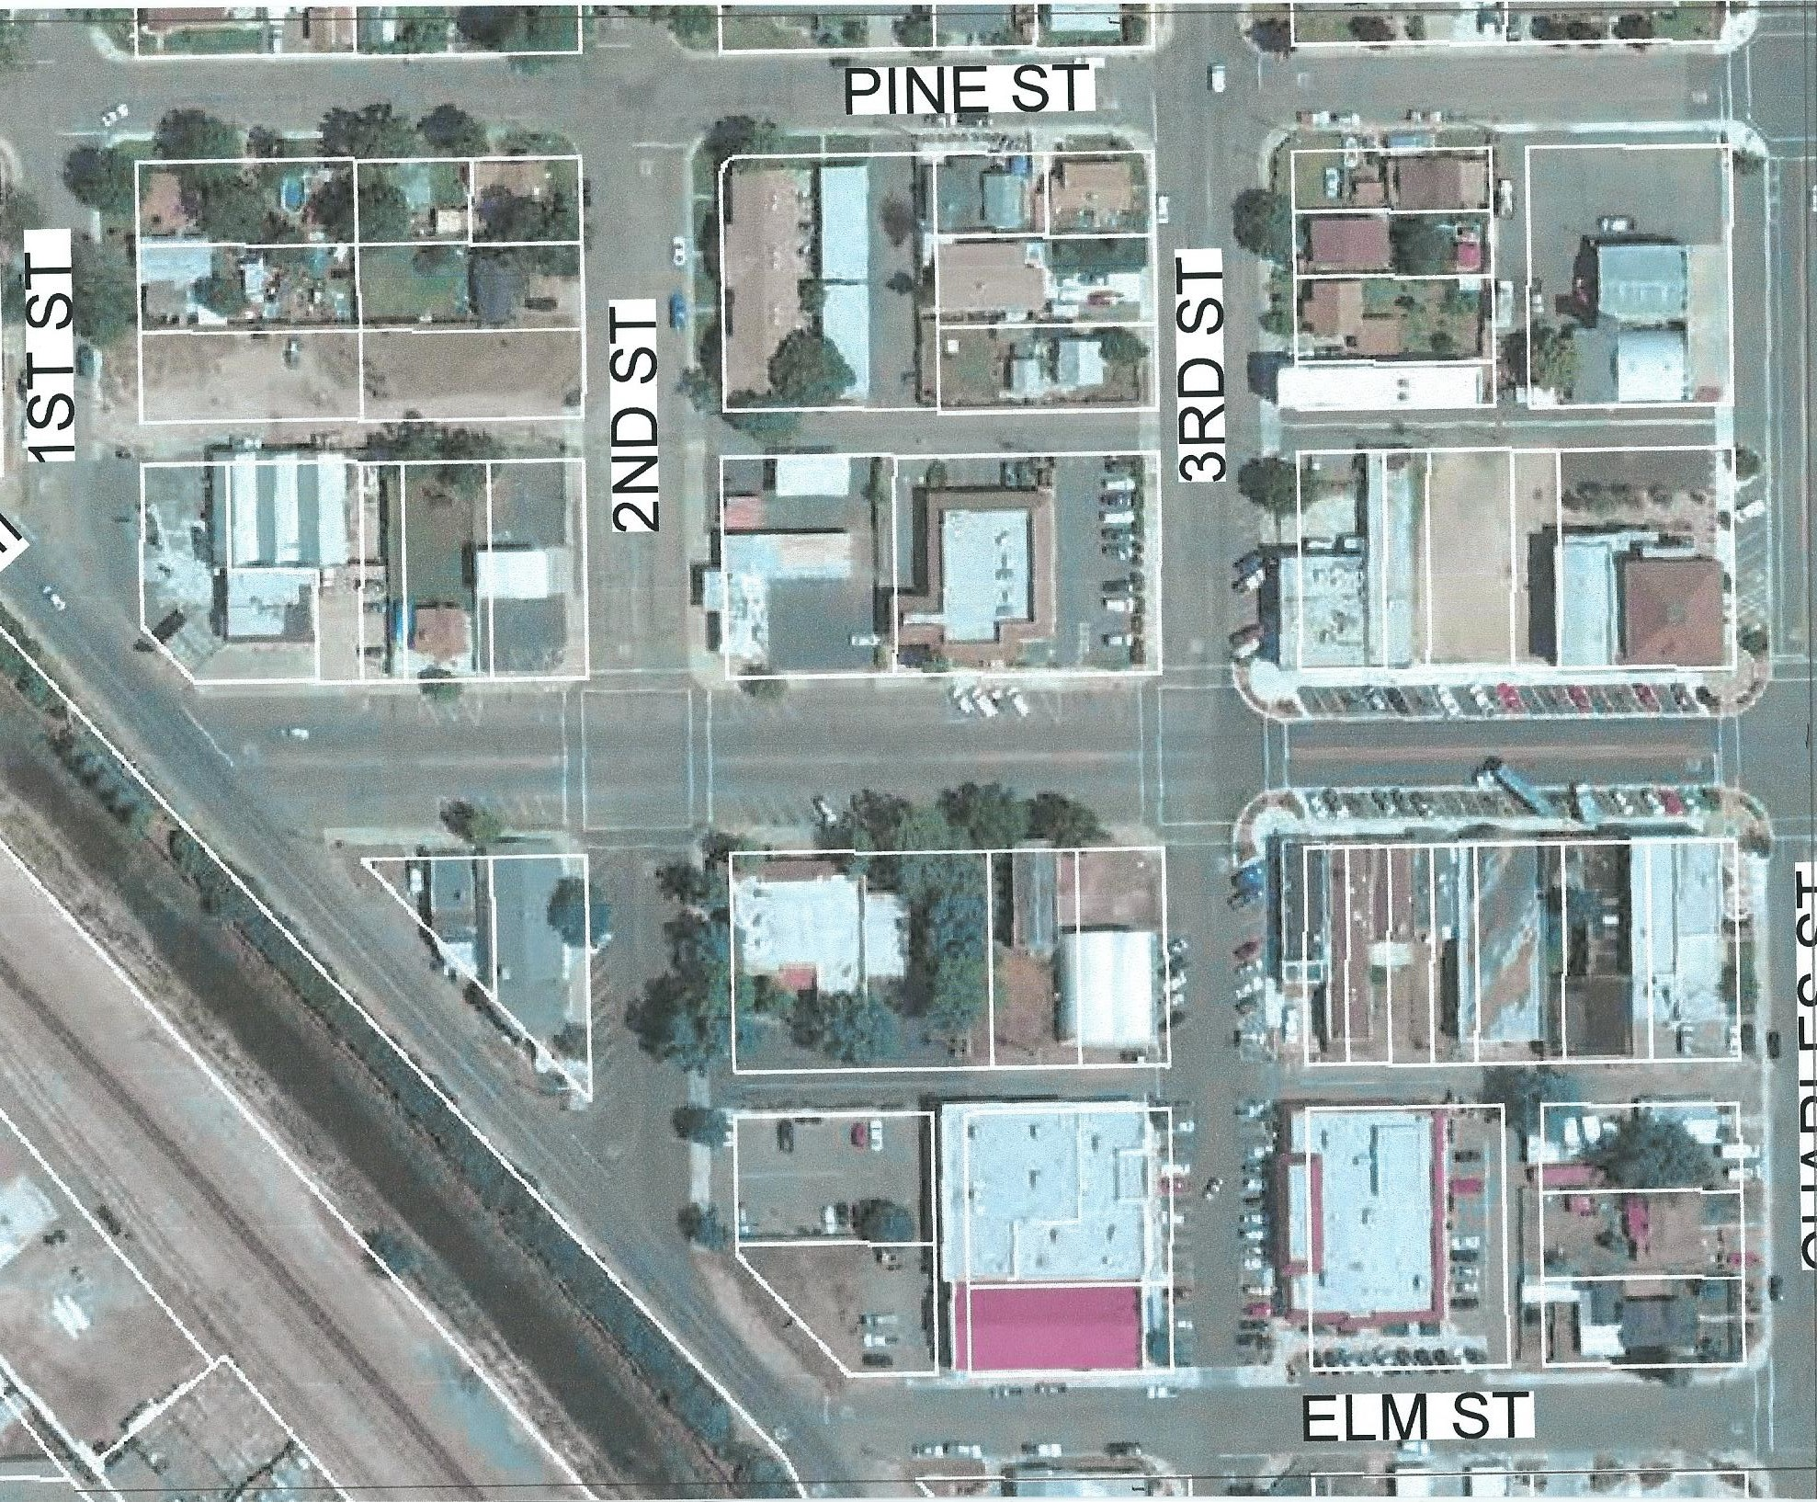
Hughson Avenue

Slide 13
Revitalization Design Considerations
Community Identity The Brand Types of Business Streetscape Vehicle Access Pedestrian Access Intersection Treatment Landscaping/Trees Street Furniture Street Art Entrance Features Traffic Circle (Roundabout) Gateway Arch Water Tank Special Events Parades Celebrations | Gathering Places Pedestrian Orientation Façade Consideration Architectural Style (brick-metal-wood) Signage Street Signs Directional Signs/Wayfinding Sign Control/Review Other Issues Pedestrian/Vehicle Conflicts Interface with High School Kids/Teenager Activities Food Trails Historic Preservation Dog Park (Offsite)

Slide 14
CPAT Approach to Revitalization
The CPAT Team came to Hughson for a two-day Workshop on Thursday, July 12th and Friday, July 13th.
Thursday consisted of a series of meetings with local Stakeholders including Agricultural Interests, the Chamber of Commerce, Downtown Business and Property Owners, and Service Clubs and Organizations. The day culminated with a Team presentation and discussion at a joint City Council-Planning Commission-Park & Recreation Commission meeting.
Friday consisted of a ’charrette’ type exercise, where participants from Thursday returned to participate in a ‘map exercise’ and a discussion to propose economic and revitalization solutions.

Slide 15
A Strategy for Revitalization
Private Sector
Public Sector
Develop a signage program to direct potential customers into the Downtown.
Rehab the Hughson water tower as a focal point.
Begin planting shade canopy trees in new planters within diagonal parking areas along Hughson Avenue.
Utilize the vacant parcel between 3rd Street and Charles Street for a temporary plaza/outdoor movie space.
Construct a roundabout at the intersection of Santa Fe Avenue-Whitmore Avenue-Third Street.
Establish a Brew-Pub at the corner of Hughson Avenue and Charles Street.
Develop a ‘Community Brand’ to promote Hughson.
Establish a communications tool to link local businesses.
Expand the existing La Perla Tapatia Market to include a meat department and fresh produce.
Develop a ‘Farm Trail’ brochure highlighting nearby agricultural products.
Establish a ‘Downtown Improvement District’ to assist in funding revitalization projects.

Slide 16
A Strategy for Revitalization
Private Sector
Public Sector
Develop a ‘pocket park’ and gathering place in the alley north of Main Street Bakery.
Develop a landscaped median with canopy trees in the center of Hughson Avenue starting at Santa Fe Avenue and proceeding east.
Erect an entry feature spanning Hughson Avenue near Second Street.
Construct a roundabout at the intersection of Santa Fe Avenue-Tully Road-Pine Street.
Utilize the pro-bono Team Architects to develop design ideas for individual buildings fronting on Hughson Avenue.
Reserve the block surrounded by Santa Fe Avenue-Hughson Avenue-Second Street-Pine Street as a future Supermarket-Shopping Center.
Establish a new permanent ‘Market Space’ on Hughson Avenue to allow surrounding agricultural products to be sold at retail (nuts, flowers and plants, salsa, fruit, jams and jellies, peanut butter).

Slide 17
Out of the Fog Comes . . . Revitalization

