Slide 1
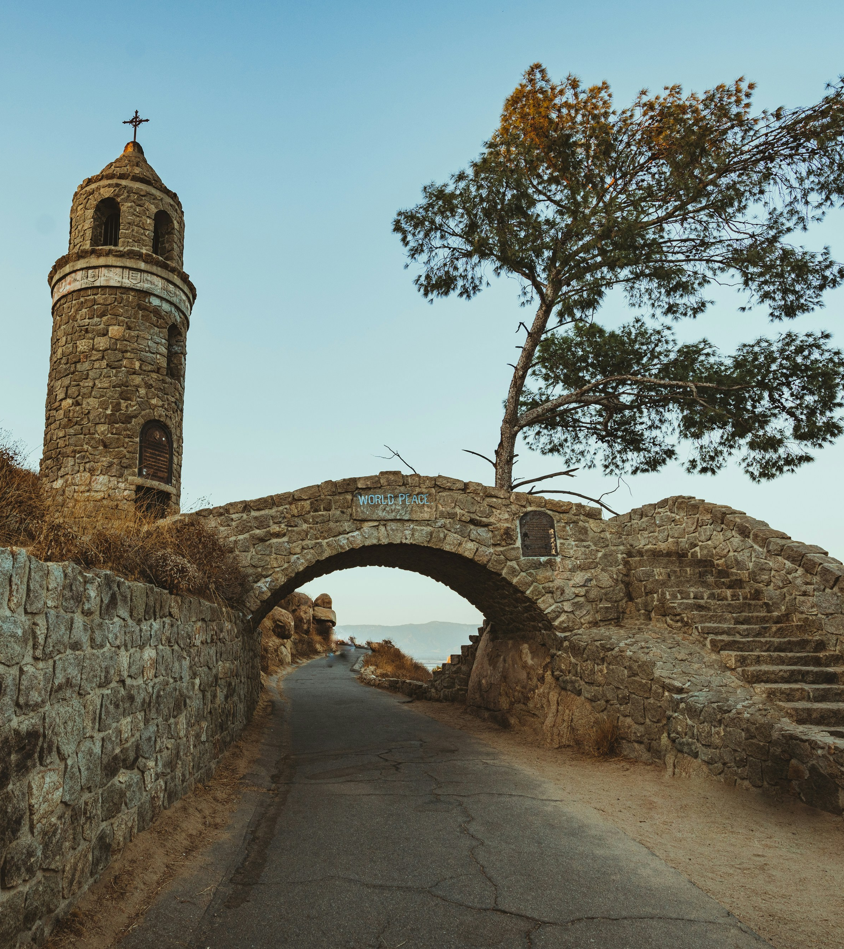



2024 Planner Remembrance

Slide 2
Remembers:
David Barquist
Scott Davidson
Warren Hoag
Joan Lamphier
Marjorie Macris
Roberta Mundie
Terrance Senik
Mark Winogrond,
….and thanks them for their service to our communities.

Slide 3
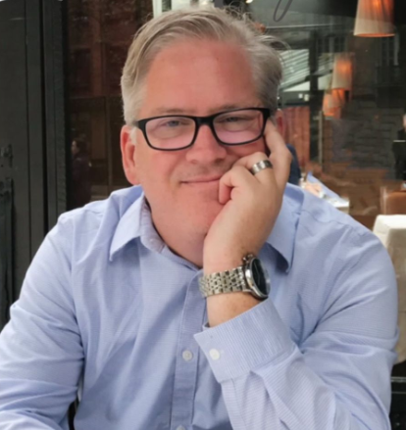
David Barquist, AICP
Orange Section APA
Kimley-Horne & Assocs., Inc.
VP, RBF/Michael Baker, Inc.
Instructor, CSU Fullerton, Urban Planning Certificate Program
California Polytechnic, Pomona
Mar 1969- June 2024

Slide 4
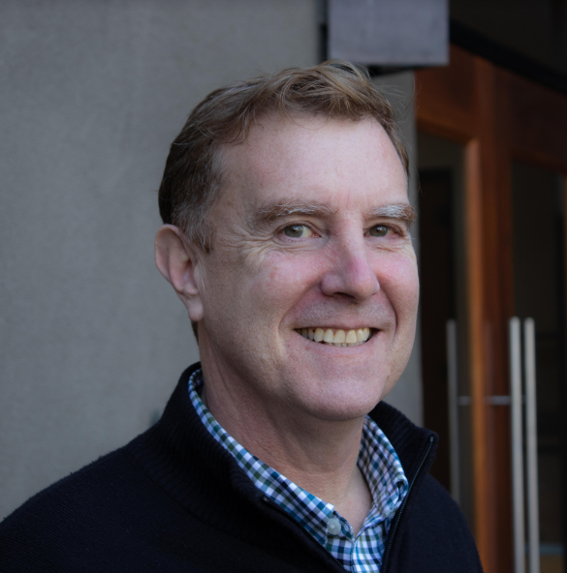
Scott Davidson, AICP
Northern Section APA
Principal, MIG Inc.
Marin County Planning Dept.
Planning Manager, City of Pinole
UC Davis, Environmental Planning and Public Policy
Aug 1964 - Mar 2024

Slide 5
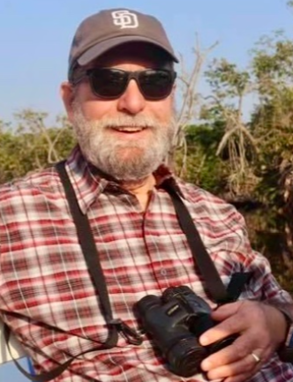
Warren Hoag
Central Coast Section APA
San Luis Obispo County, Planning and Building Dept.
Architecture Review Committee, Arroyo Grande
SLO County, Agriculture Liaison Board
Grover City Planning Department
UC Santa Barbara, BA Geography Policy
Jan 1949- Nov 2023

Slide 6
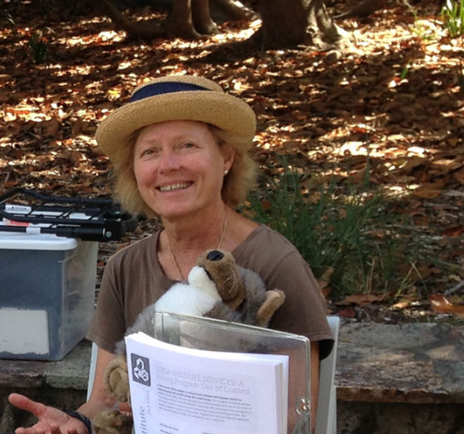
Joan Lamphier
Northern Section APA
Principal and Founder, JML Planning, and Lamphier - Gregory Planning
Project Coyote Advisory Board
Volunteer in several environmental and conservation organizations
UC Berkeley, MCP
July 1942- Nov 2023

Slide 7
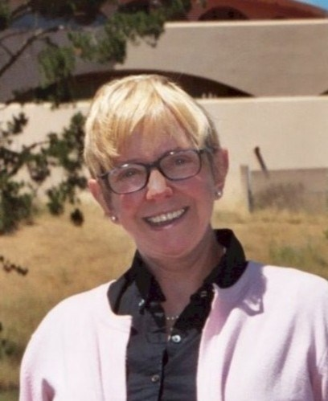
Marjorie Macris, FAICP
Northern Section APA
“Planning Pioneer”
Director, Berkely Planning Dept.
Director, Marin County Planning Dept.
Author, Planning Commissioner Handbook, Solano Press
Service on numerous environmental and conservation boards
Univ. of Illinois, Urbana-Champaign
July 1935- Oct 2023

Slide 8
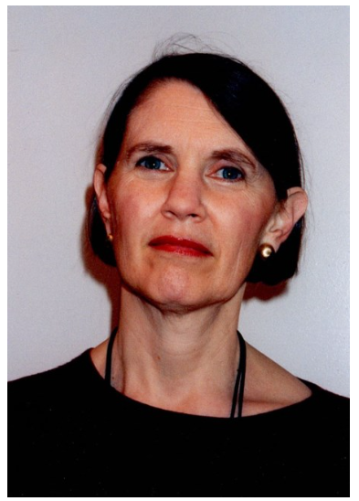
Roberta MUNDIE
Northern Section APA
Mundie and Associates, Environmental Consulting
California Planning Roundtable projects in housing, infrastructure and environmental protection
Harvard University, MCP
Apr 1944 - Oct 2023

Slide 9
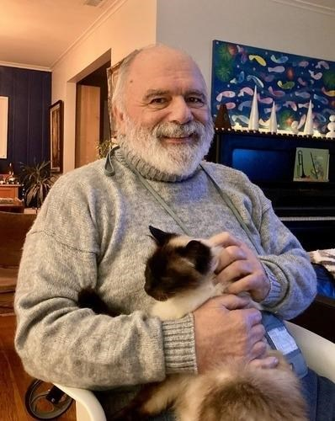
Terrance Senik
Northern Section APA
Director, Economic and Comm. Development, Daly City
Initiated feeding programs for unhoused persons in San Francisco
Illinois State University, Geography/Geology
Sept 1947 - Dec 2023

Slide 10
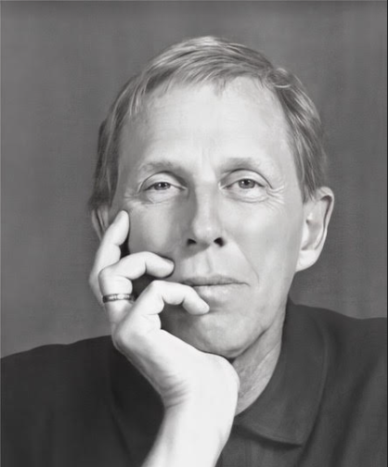
Mark Winogrond, FAICP
Los Angeles Section APA
Principal, Planmark Associates
Legacy of groundbreaking award-winning planning in the cities of:
    Culver City
    West Hollywood
    Lawndale
    San Francisco
University of Rhode Island, MCP
Jan 1947 - Feb 2024

Slide 11
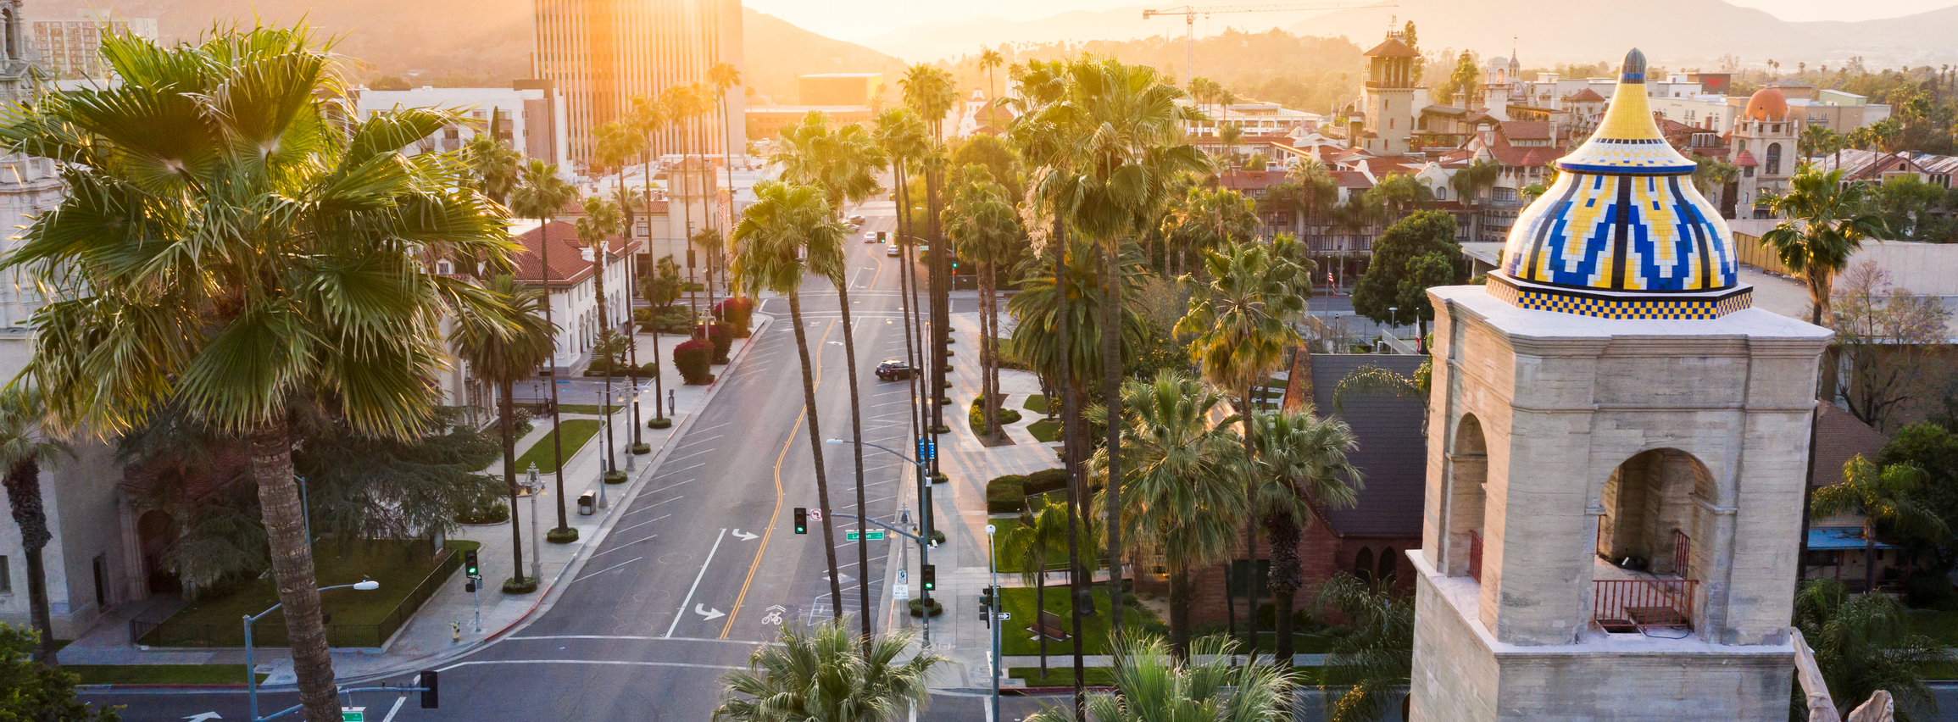

In Remembrance,
    We acknowledge and celebrate their impact and achievements in planning.

Slide 12
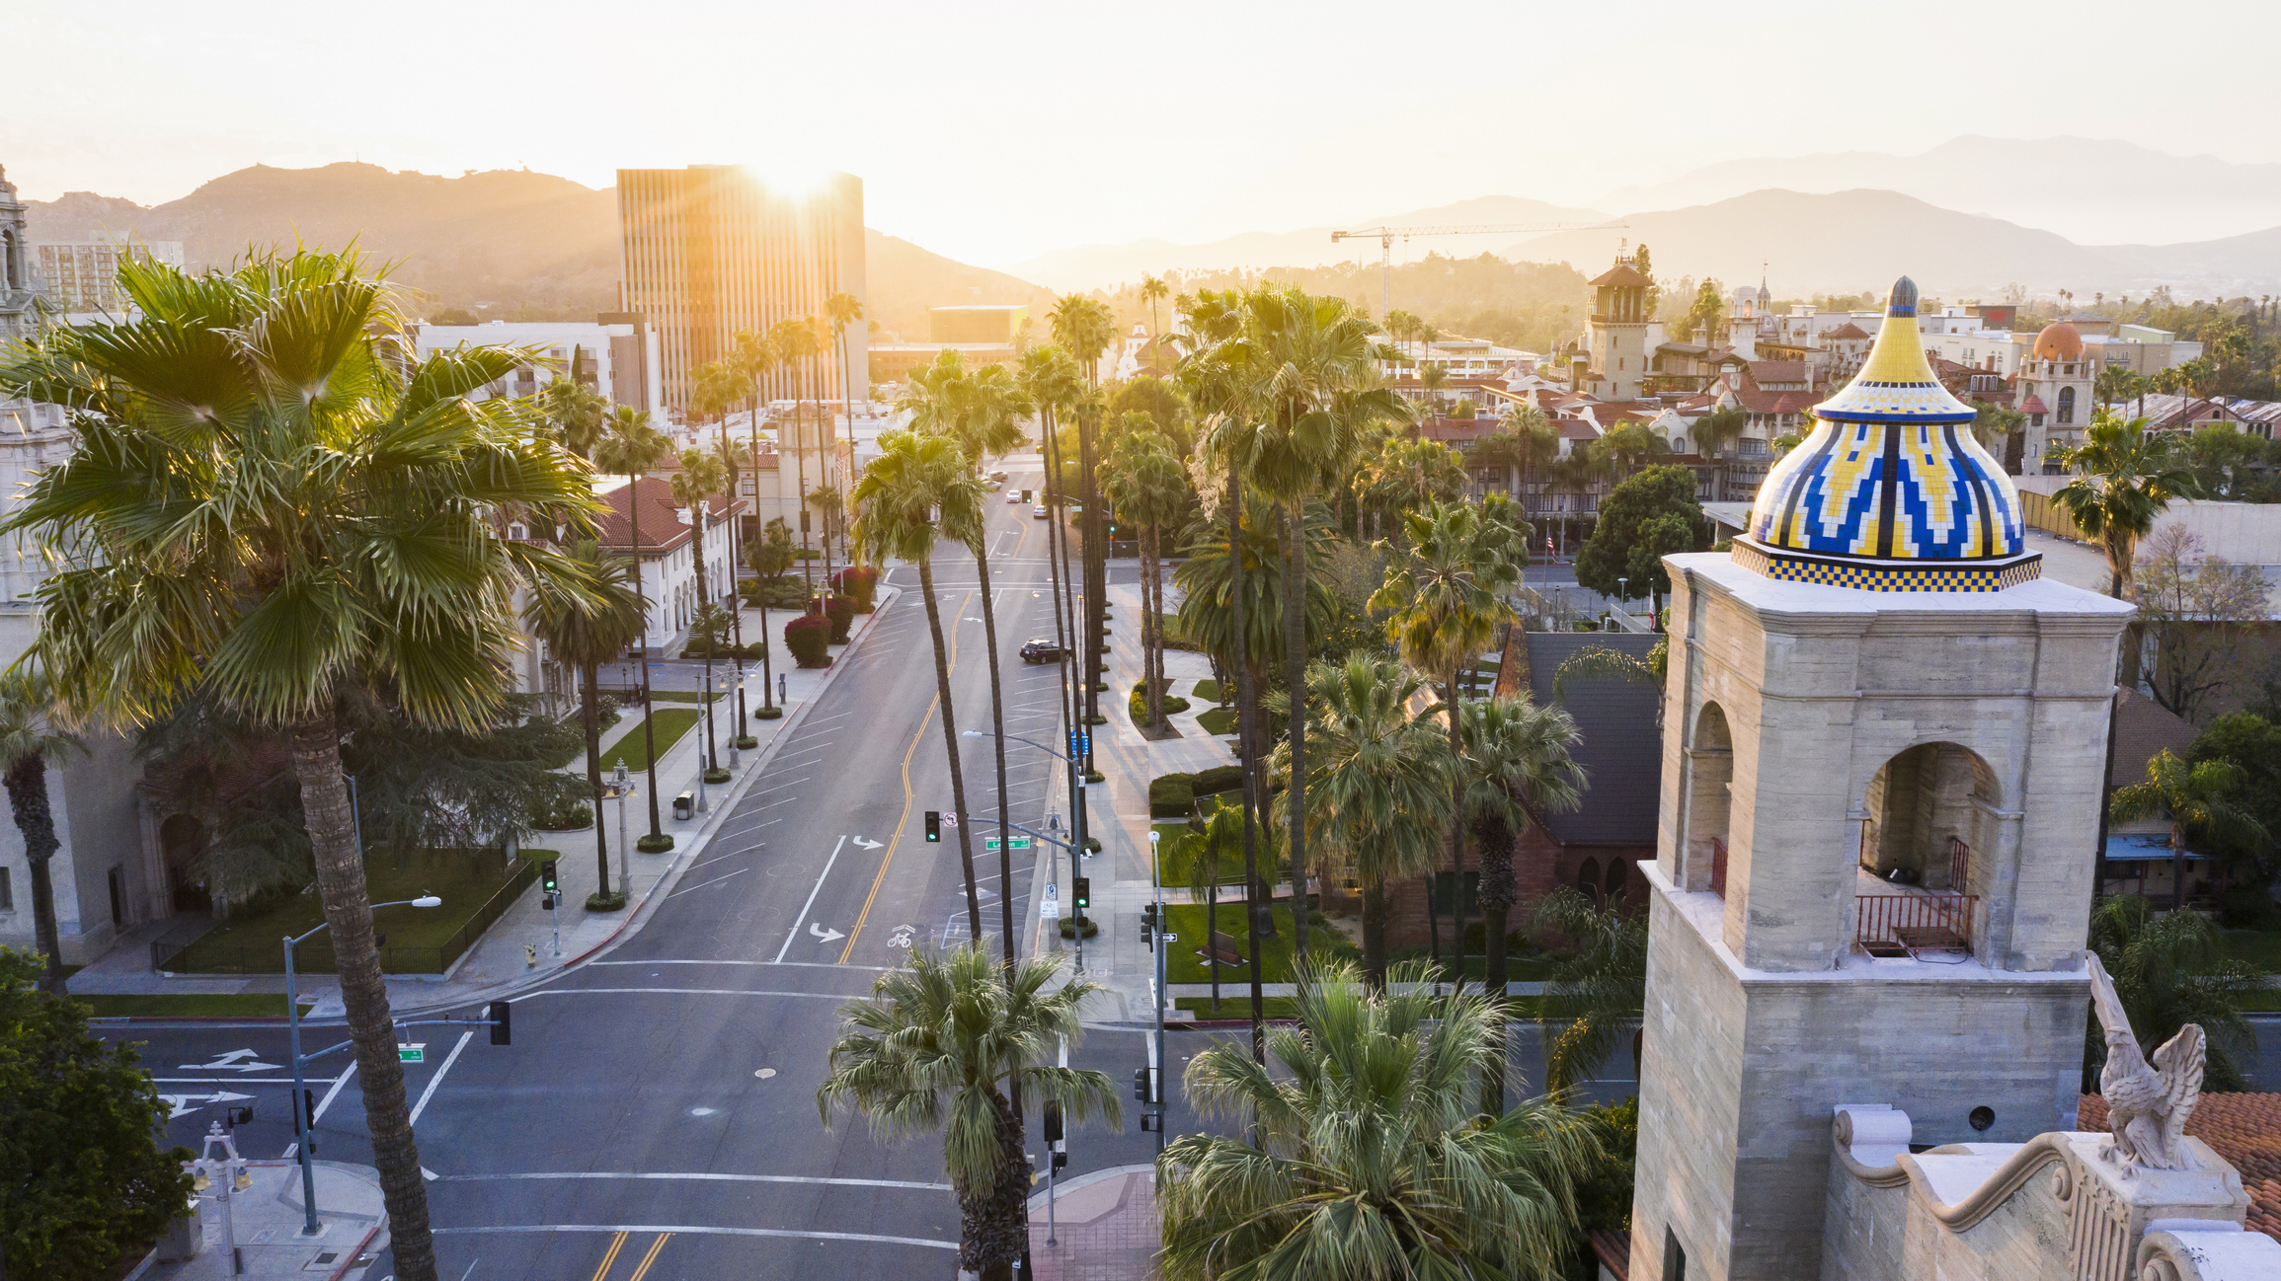
THANK YOU
We hope to see you next year!
Music “September” performed by Joseph R. Lilore,
Courtesy of CC by FMA (Free Music Archive)

